Slide 1
Income tax of a salaried person
Done by Sushmita Kumari & Rani Kumari

Slide 2
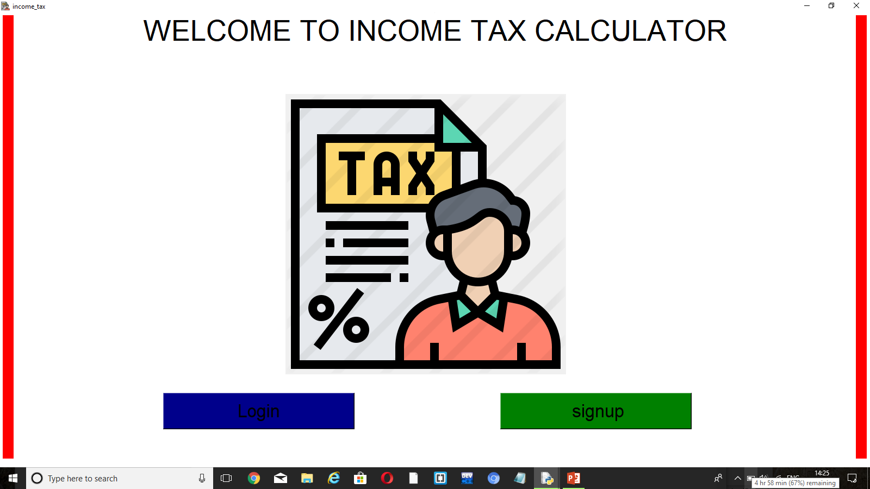

Slide 3
How to calculate income tax?
Income from salary is the sum of Basic salary + HRA + Special Allowance + Transport Allowance + any other allowance. Some components of your salary are exempt from tax, such as telephone bills reimbursement, leave travel allowance. If you receive HRA and live on rent, you can claim exemption on HRA. Calculate exempt portion of HRA, by using this HRA Calculator.

Slide 4
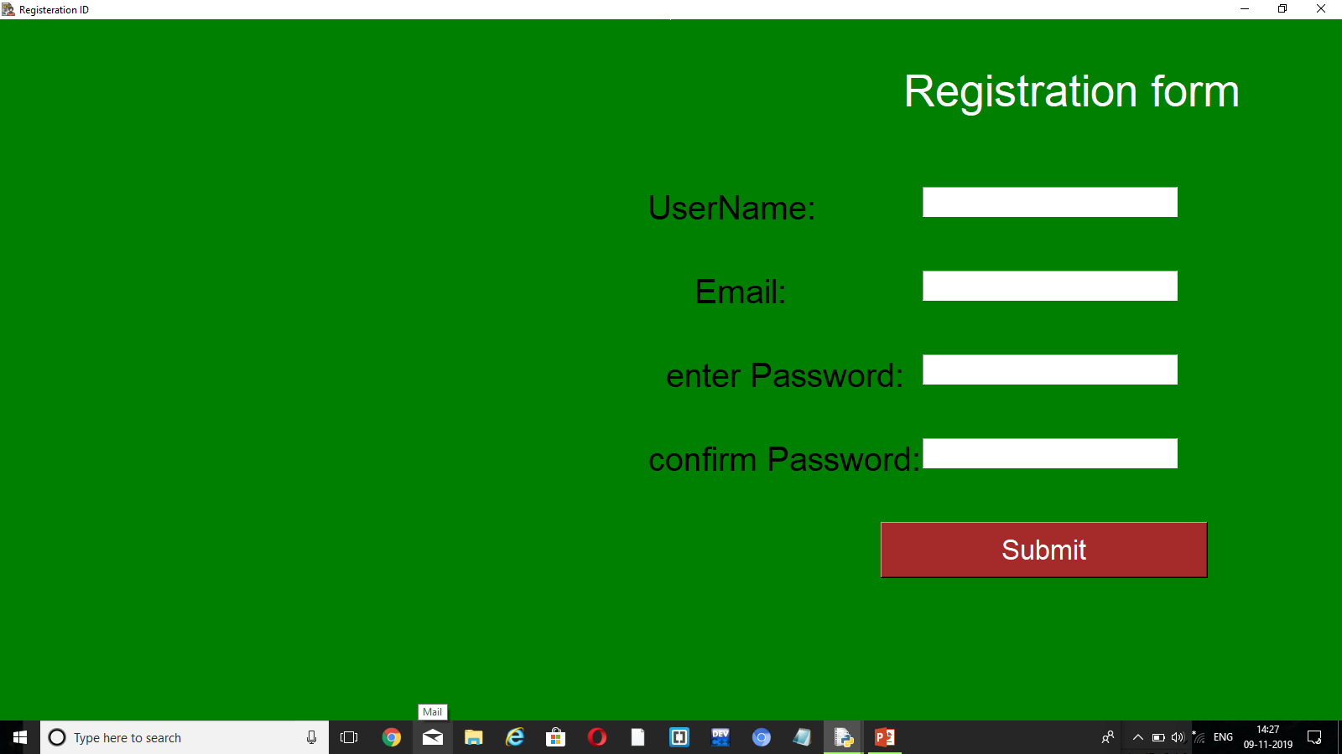

Slide 5


Slide 6
How to calculate income tax
Up to Rs 2,50,000 | Exempt from tax | 0
Rs 2,50,000 to Rs 5,00,000 | 5% (5% of Rs 5,00,000 less Rs 2,50,000) | 12,500
Rs 5,00,000 to Rs 10,00,000 | 20% (20% of Rs 6,82,000 less Rs 5,00,000) | 36,400
More than Rs Rs 10,00,000 | 30% (nil) | 0
Cess | 4% of total tax (4% of Rs 12,500 + Rs 36,400) | 1,956
Total Income Tax | Rs 12,500 + Rs 36,400 + 1,956 | Rs 50,856

Slide 7
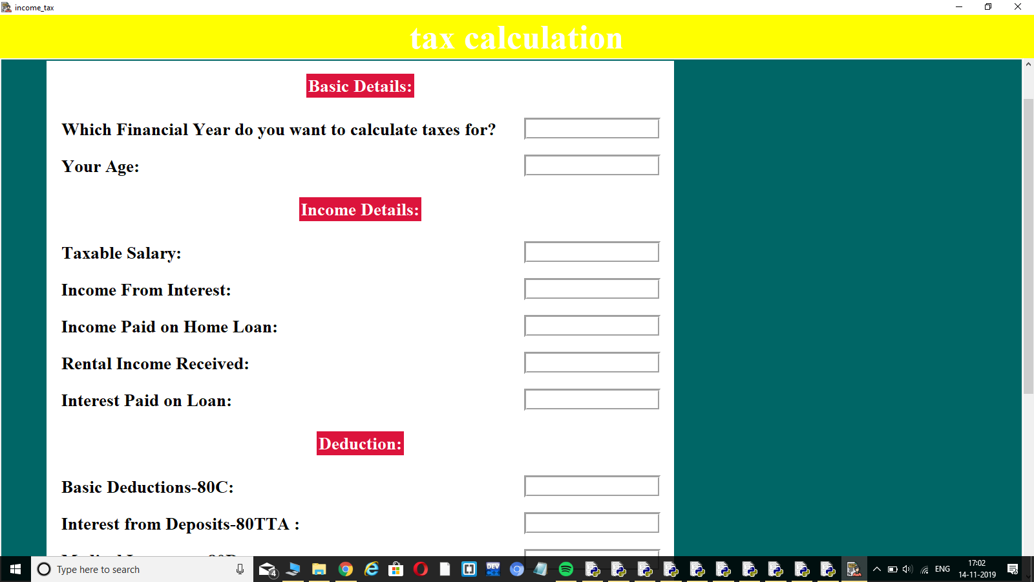

Slide 8
deduction
Nature | Maximum Deduction
Section 80C | Rs.1,50,000
Section 80D | Rs 25,000 for self Rs 50,000 for parents
Section 80TTA | 10,000

Slide 9
How to calculate
Nature | Amount | Exemption/Deduction | Taxable
Basic Salary | 6,00,000 | - | 6,00,000
HRA | 3,00,000 | 1,80,000 | 1,20,000
Special Allowance | 1,56,000 | - | 1,56,000
LTA | 20,000 | 12,000 (bills submitted) | 8,000
Standard Deduction | - | 50,000 | -
Gross Total Income from Salary |  |  | 8,34,000

Slide 10
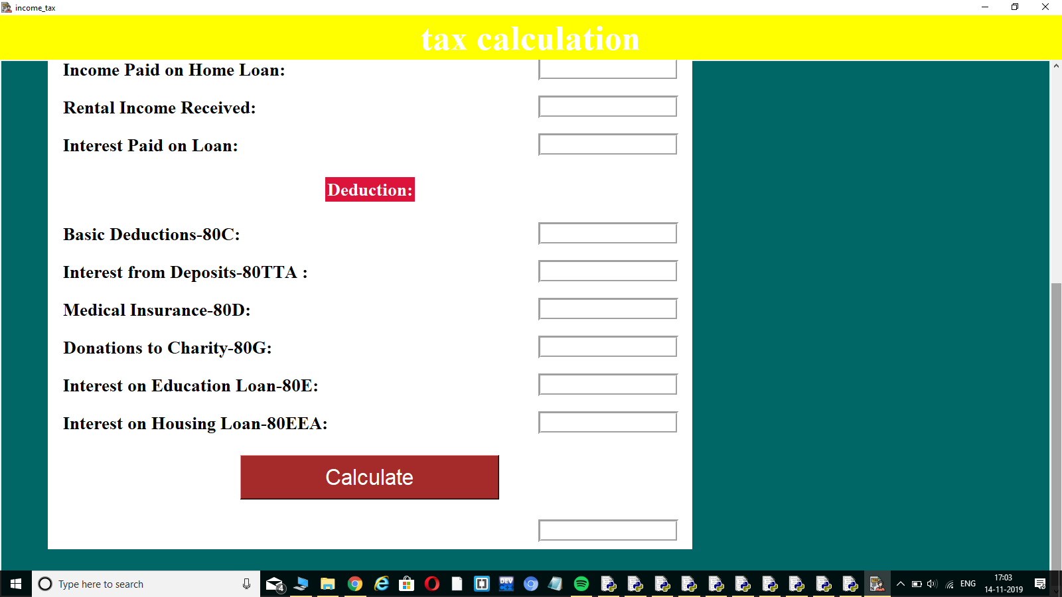

Slide 11
Nature | Amount | Exemption/Deduction | Taxable
Basic Salary | 6,00,000 | - | 6,00,000
HRA | 3,00,000 | 1,80,000 | 1,20,000
Special Allowance | 1,56,000 | - | 1,56,000
LTA | 20,000 | 12,000 (bills submitted) | 8,000
Standard Deduction | - | 50,000 | -
Gross Total Income from Salary |  |  | 8,34,000

Slide 12
References: https://www.incometaxindiaefiling.gov.in/home https://en.wikipedia.org/wiki/Income_tax_in_India https://youtu.be/Hr4UuuClgnA

